Slide 1
Cold Storage management system

Slide 2
Presented By
Shibly Sirajee
Ahmad Hussain Zamee
2013-2-60-035
2013-2-60-024

Slide 3
Introduction
This system is basically concerned with the reservation of space to refrigerate something.
Booking space, Maintain employee ,Maintain Space.
Insert, Update, Delete and Modify

Slide 4
Motivation
Cold Storage Management System will reduce a huge pile of work and complications.
We can calculate income from Cold Storage system in a easy way.
Managing all the information will be easy and fast that will reduce users and employees sufferings.
Save time & Paper work.

Slide 5
Scope
We can extend our database to automate everything that is covered by cold storage system. Like Automating users space allocation, employee’s salary and bonus etc.
Can be replaced by online-booking to make easy for users .

Slide 6
Contribution
All the manual work is converted to computerized so that the load of employees will decrease.
Easy to store information and fast accessing of information.
Centralized management reporting and decision support.
Accurate and timely control program.
To make it easy for fast processing and modification.

Slide 7
Details
Admin
Employee
Who can access, update and modify everything.
He can access the space, allocate new space for user or make free of space.
He can’t update,modify or access anything. He can only view free space for booking and make a request to an employee for reservation.
User

Slide 8
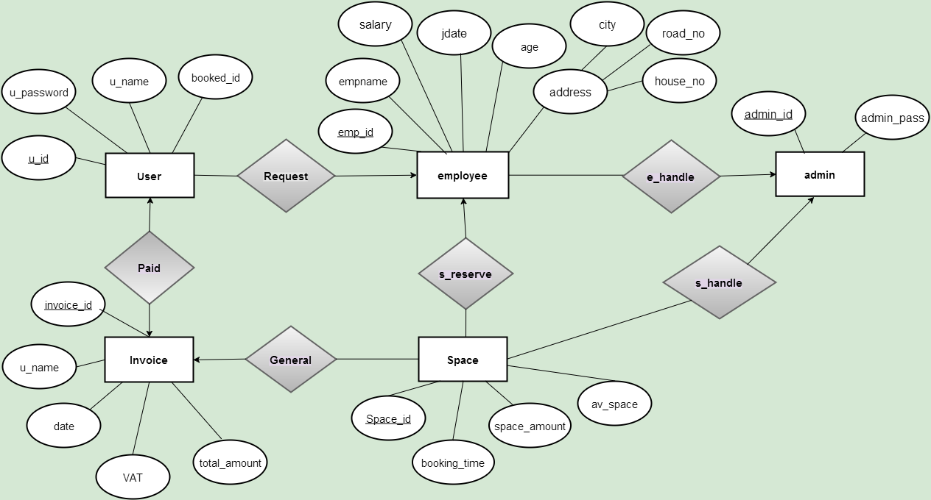
E-R Diagram.

Slide 9
E-R Diagram Details
Admin have all access power to employee and space.He can update,modify or delete anything from employee and space table. That is One to Many Relationship.
User can request for a reservation to an employee and an employee also get request from many user. That is Many to One Relationship.
An employee can reserve many space. That is One to Many Relationship.
A invoice can be created consist of many space’s information. That is One to Many Relationship.
One invoice is transferred to one user. That is One to One Relationship.

Slide 10
Tabular representation
user(u_id , u_name, u_password,booked_id,emp_id).
employee(emp_id,emp_name,jdate,age,city,road_no,house_no,salary,admin_id)
admin(admin_id,admin_pass).
invoice(invoice_id,u_name,date,total_amount,VAT,u_id)
space(space_id,admin_id,booking_time,av_space,space_amount,emp_id,invoice_id).

Slide 11
Normalization
From the table user,employee,admin,space & invoice,we observe that all tables supports 4NF,because all tables primay-key is set and there has no partial-key dependency,transitive dependency, multivaued dependency.

Slide 12
Conclusion
Through this management system,it provides ease of access and maintenance that gives cold storage management system a window to digitalization.

Slide 13
Refference
http://www.datexcorp.com/industries/cold-storage
https://www.draw.io/
https://www.youtube.com/watch?v=J-axThMG3R4

Slide 14
Thank
You...

